Slide 1
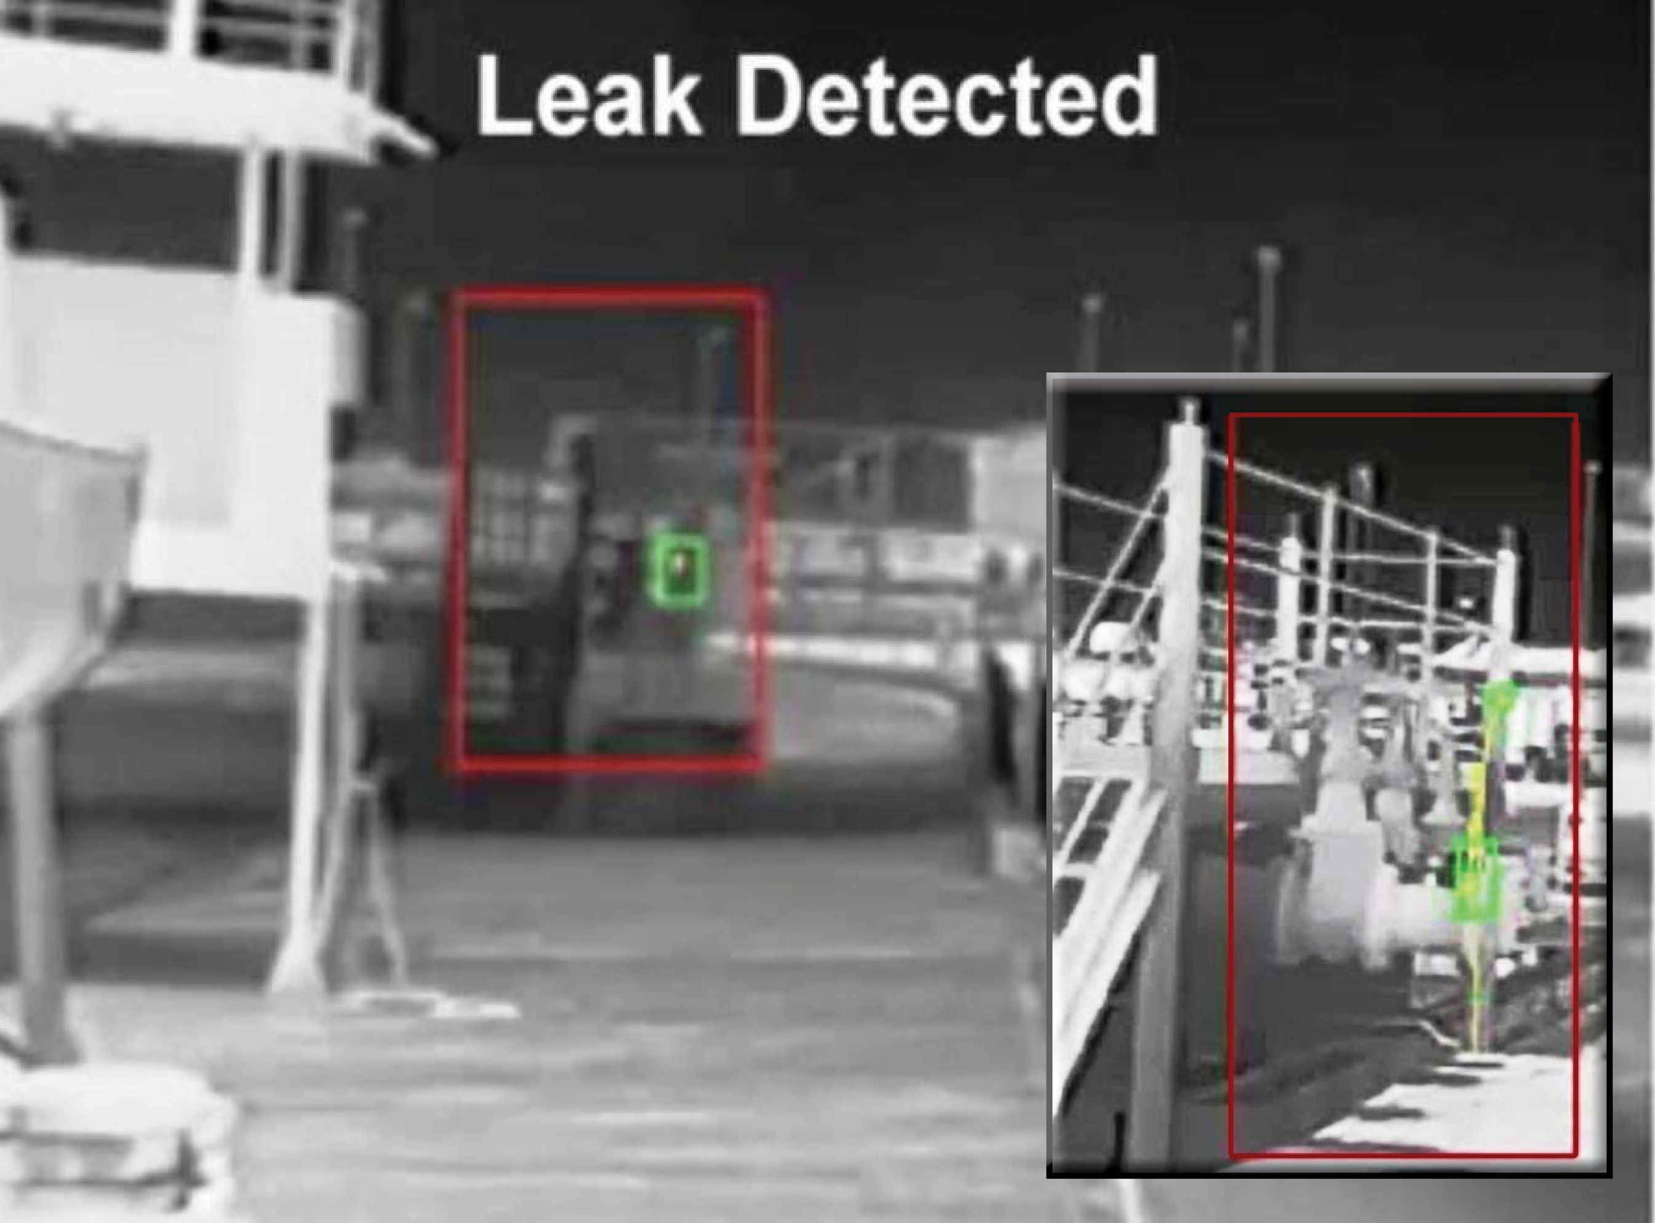
LPG Gas
Leakage Detector
Project Name :
Microprocessor microcontroller Project

Slide 2
Group Members
Maj Sadab Mehjabin
(201914001)
Afnan Alauddin Mumu
(201914047)
Lt Nahid Hasan Shourav
(170214143)

Slide 3
Components
GSM Module
Buzzer
Arduino UNO
LCD
DC Motor(Ventilation)
Gas Sensor
PWM controled servo motor(Window servo)

Slide 4
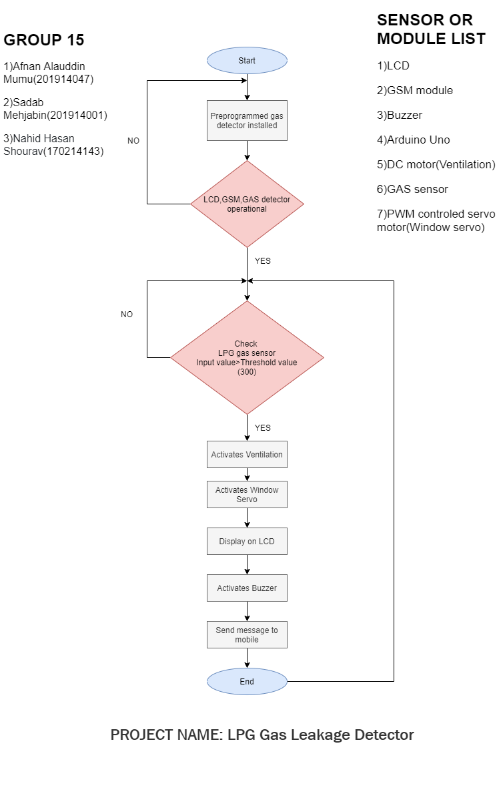
Flowchart

Slide 5
Working Procedure
Arduino will be active with 5 volts‟ power supply.
The sensor will detect gas leakage once the system is launched, if there is no gas leakage, it will display "Normal Condition Air Cleaning" on the display.
If the gas is leaked otherwise, the following three steps will follow :
Step 1: A signal from the microcontroller will go to the display and show gas leakage message there.
Step 2: The signal from Buzzer will signal when the first step is completed.
Step 3: Lastly, through GSM, there will be a signal message that the gas has been leaked to a specific number or multiple.

Slide 6
Features
We have used a MQ-2(LPG gas sensor) to detect LPG Gas.
When LPG gas leakage occurs, arduino continuously reads it and alert message is shown on LCD will indicate the affected area.
Thus the emergency exit servo motor, as well as the ventilation motor is activated.
Besides, the buzzer is turned on and a message is sent to owners mobile to notify that gas leakage has been occurred.
We can set the sensitivity of this sensor module by inbuilt potentiometer located on it.

Slide 7
End

